Slide 1

AACS3044 Computer Game Programming
Programming Sound

Slide 2
Sound in Games
Sound adds emotional engagement to games when it is used appropriately.
  Consider the ominous ambient sounds of Resident Evil, the effects of which compound the tension and horror as you happen upon those relentless zombies chewing up your Alpha Team comrades.
  Even early games like Space Invaders earned much of their addictive appeal by getting into your head with thumping, repetitive sound schemes. As the aliens got faster and closer, the music got faster and louder.
Properly designed, sound and visual cues work together to produce an experience greater than the sum of their parts.

Slide 3
What can sound do in games?
Sound can be used to
  Set the mood
  Building tension
  Or Celebrate
In the context of software development, sound is another medium of feedback we can give to users in addition to visual.
  Eg. When selected a button on a game. Sound effect of the button is played.

Slide 4


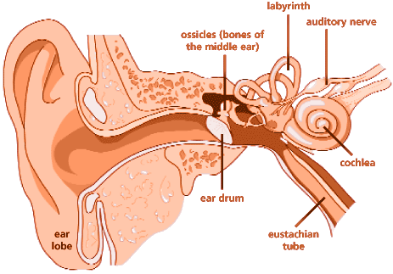
The nature of sound
Sound is a complex relationship involving a vibrating object (sound source), a transmission medium (usually air), a receiver (ear) and a preceptor (brain).
Vibrating
object
Molecule around
vibrates
Information
processed
Ear drum
vibrates

Slide 5
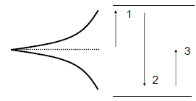
The nature of sound
Sounds are vibration of air usually termed as waveform.
The unit of regularity is called a cycle or known as Hertz (Hz) after Heinrich Hertz (a pioneer in the field of acoustics).
1,2,3 are the path the object traverse to complete a cycle
vibration

Slide 6
The nature of sound
Sound can be characterised as:
  Frequency (pitch) is the count of complete cycles for a wave measured in Hz (Hertz).
  Human hearing frequency falls in the range of 20 to 20,000 Hz (20 KHz).
  Amplitude is the loudness of the sound measured in dB (decibel).
  Timbre defined as the quality of the tone.
  All sound has its own duration.

Slide 7
DirectSound?
Depreciated and replaced with XACT and XAUDIO
  Can still be used (moved to directsound.h/lib), but the DirectSound library is ancient and very troublesome to use.
  XACT requires a standalone software to compile the audio files
  XAudio is the replacement for DirectSound, and as such, it is also very low level, and tedious to use.
BUT WE STILL WANT SOUND!

Slide 8
How does DirectSound Work?
For concept sake:
DirectSound manages the sound data through the use of buffers.
  Buffers are areas of memory that hold sound data.
When you’re using DirectSound, you can have multiple buffers that hold any sound data you want to load.
You can then manipulate or play the data within these buffers.
  DirectSound mixes these sounds into a single buffer.
  This single buffer contains the final sound that the user hears.
The sound buffers can reside either on sound card memory or in system memory.

Slide 9
Types of buffer in DirectSound
Primary buffer.
  All sounds played are mixed into the primary buffer. The sound card uses the resulting mixed sound in the primary buffer to create the actual sound that you hear.
Secondary buffer.
  These are the buffers that hold all the sound data that your game needs. DirectSound lets you play multiple sounds by accessing more than one secondary buffer simultaneously.
Static buffer.
  When sound data is of limited size, you can create a static or fixed size buffer. This buffer allows for the complete loading of a particular sound into memory.
Streaming buffer.
  Sometimes, sounds that you want to play might be too large to fit into memory at one time. In this instance, you need a streaming buffer. The streaming buffer allows for only a portion of a sound to be loaded into it before being sent off to be played. As the sound within the streaming buffer is played, new sound data is loaded into it.

Slide 10
Example of DirectSound’s complexity
STEP 1: Creating DirectSound Device
STEP 2: Enumerate the devices
STEP 3: Setting the Cooperative Level
STEP 4: Setting up Secondary Buffer
STEP 5: Creating a Secondary Buffer
STEP 6: Reading the Sound Data into the buffer
STEP 7: Locking the Sound Buffer
STEP 8: Unlocking (only for manipulation after loading)
STEP 9: Resetting WAV and place data into secondary buffer
FINALLY, we can play and control the sound…

Slide 11
FMOD TO THE RESCUE!
FMOD is a proprietary audio library made by Firelight Technologies that plays music files of diverse formats on many different operating system platforms, used in games and software applications to provide audio functionality.
Prior to version 3.75, the library was named simply as FMOD. Since then, the FMOD sound system has been redesigned and now contains three main parts:
FMOD Ex, the low-level sound engine
FMOD Event System, more abstract, higher level application layer to simplify playback of content created with FMOD Designer
FMOD Designer, the sound designer tool used for authoring complex sound events and music for playback
The FMOD sound system has an advanced plugin architecture, that can be used to extend the support of audio formats or to develop new output types, e.g. for streaming.
~http://en.wikipedia.org/wiki/FMOD

Slide 12
FMOD LICENSING
FMOD is available under multiple license schemes:
FMOD Non-Commercial License, which allows software not intended for commercial distribution to use FMOD for free.
FMOD Commercial License, licensed on a per-platform basis. Intended for commercial software and games.
FMOD Casual License, a variant of the commercial license intended for electronically distributed titles, such as those distributed via the Xbox Live Arcade, PlayStation Network, Nintendo WiiWare, Windows and Mac OS X via download, as well as various mobile application distribution channels.

Slide 13
Lets begin!
Setting up:
Step1: Go to https://www.fmod.com/download and download the FMOD Studio API. (I will be using the one for Windows). You may need to create an account to sign in before this.
Step 2: Install the API
Step 3: …
Profit!

Slide 14
Integrating with Visual Studio
A number of steps:
Create/load your project
Go to the properties window
Under Configuration Properties->VC++ Directories
Go to “Include Directories”, dive in and navigate to your FMOD directory, eg: “C:\Program Files (x86)\FMOD SoundSystem\FMOD Studio API Windows\api\core\inc”.
As we are in “Include Directories”, we select the “inc” folder.
Go to “Library Directories”, dive in and navigate to your FMOD directory again.
As we are in “Library Directories”, we select the “lib” folder.
Go deeper and select the x86 folder
Go to the Linker -> Input section, and add “fmod_vc.lib” under additional dependencies

Slide 15
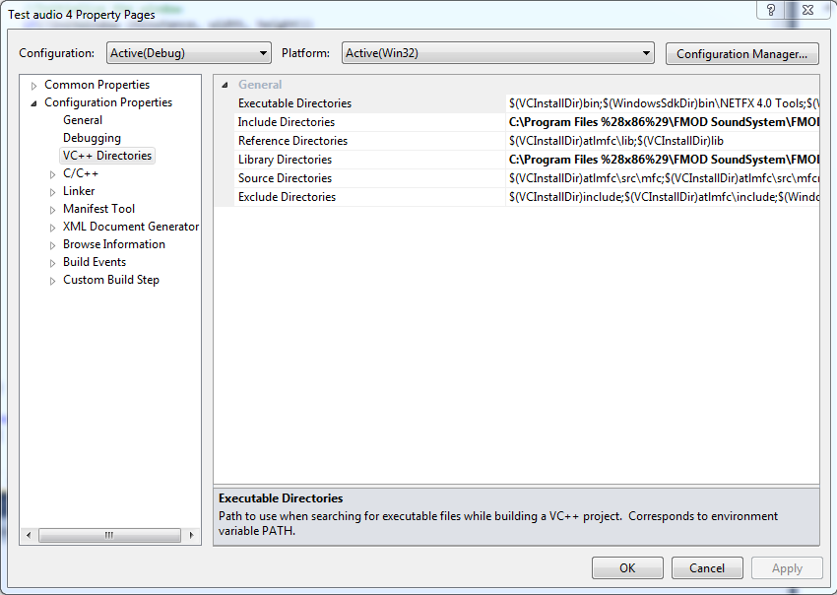
Integrating with Visual Studio

Slide 16
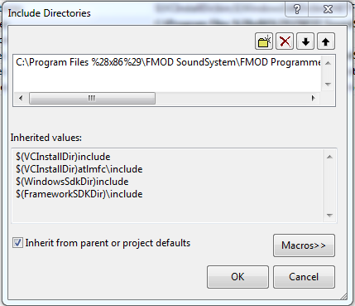
Integrating with Visual Studio
Click the folder icon to drill down to the correct folder

Slide 17
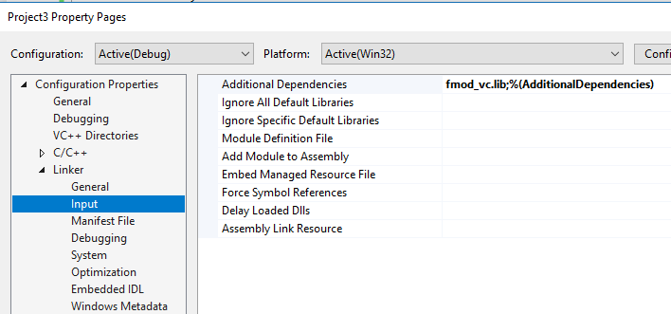
Integrating with Visual Studio

Slide 18
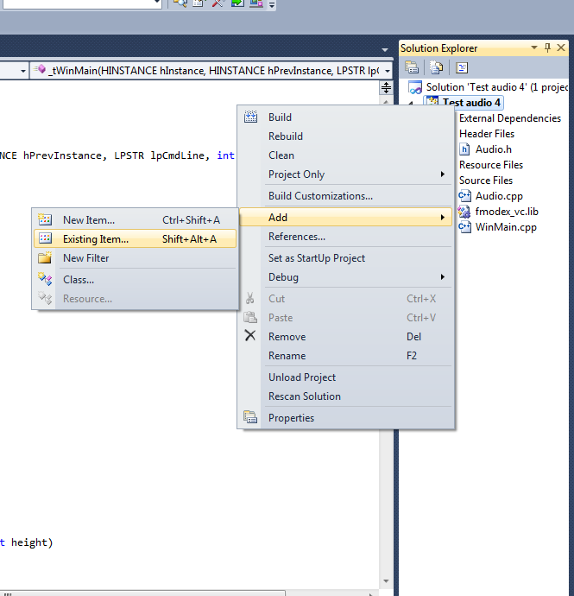
Integrating with Visual Studio
Right click on “Source Files”
Select “Add” -> “Existing Item”
Browse back to your FMOD folder, drill into the “lib” folder, and select the “fmod.dll” and fmodL.dll file.

Slide 19
Integrating with Visual Studio
Not done yet!
Go to Windows Explorer/My Computer
Browse to your FMOD folder
Drill to the “api” folder
Copy “fmod.dll” and fmodL.dll
Paste it into your project folder (hint: look for your winmain.cpp file location)

Slide 20
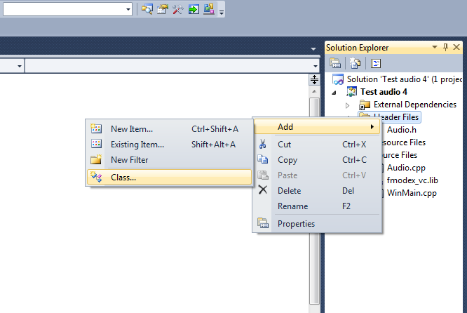
Ready to go!
Lets create a simple class to get some sound going.
Right click on “Header Files” in your solution explorer
Select “Add” -> “Class”
Name it Audio

Slide 21
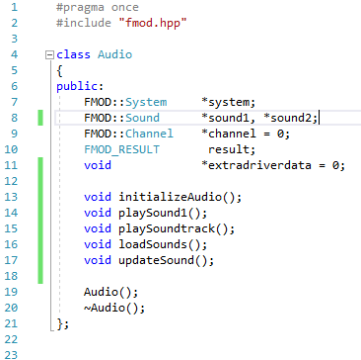
Audio.H
Create the Attributes. System, result and channel are compulsory. You can make however many sounds you want.
And the behaviours of this simple Audio class header. Here we assume 2 different sounds will be used.

Slide 22
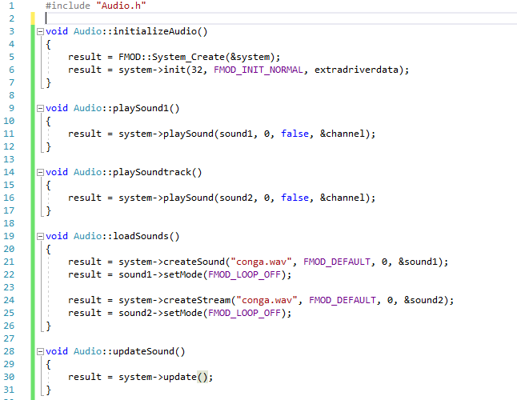
Audio.cpp
Creating the main system object
Specifying how many channels the system object will have
Flags, we leave as default
Extra driver data, we’ll ignore.
Pointer to what sound to play
Address of a channel handle pointer that receives the newly playing channel
Paused or not?
Address of a variable to receive a newly created FMOD::Sound object
Filename, make sure the path is correct
No loop
Must be called once a frame

Slide 23
To understand the parameters
Navigate to your FMOD installation folder
Drill to the documentation folder, eg: “C:\Program Files (x86)\FMOD SoundSystem\FMOD Programmers API Windows\documentation”
Open fmodex.chm
Browse to your hearts content. This is useful to know the parameters of the functions you will be using, and what they mean
You can also refer to “Getting started with FMOD for Windows.pdf” for some tips and further understanding of FMOD

Slide 24
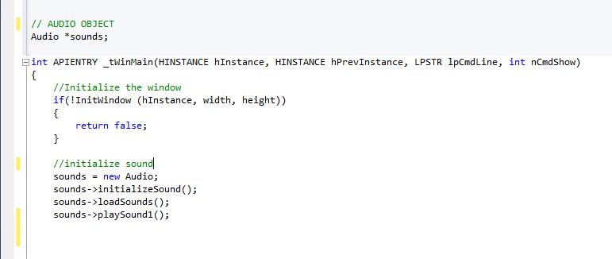
Play my song!
Creating a pointer to an Audio object
Creating the Audio object, and pointing our pointer to it
Using the pointer to the object, we initialize the object
Command the object to execute it’s loading function which loads our sounds into the channel
Play the sound!

Slide 25
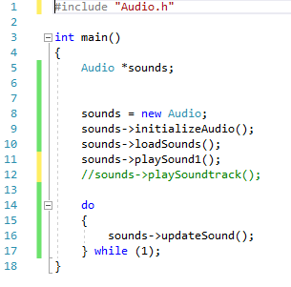
Play my song!
Creating a pointer to an Audio object
Creating the Audio object, and pointing our pointer to it
Using the pointer to the object, we initialize the object
Command the object to execute it’s loading function which loads our sounds into the channel
Play the sound!

Slide 26
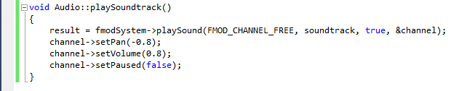
Manipulating sound
Pause the sound
Manipulating the sound

Slide 27
Manipulating sound
Pan
Frequency shift
Low pass/high-pass filter
Volume
Effects
Loops

Slide 28
Don’t forget: Object oriented
Redesign the Audio class to become more suitable for a game that will have to take in considerations such as:
Multiple characters
Multiple effects
Multiple levels
Dynamic music
Consider carefully the hierarchical level of the class before you do any design.

Slide 29
Where and how?
Music
Collisions
Keypress
Mouse clicks
Mouse move
AI behaviour
Environment behaviour
???

